Slide 1
Pruning Neural Networks for Inductive Conformal Prediction
11th Symposium on Conformal and Probabilistic Prediction with Applications
Xindi Zhao and Anthony Bellotti
University of Nottingham, Ningbo, China

Slide 2
Outline
OUTLINE
Introduction
Neural pruning
Motivation
Contribution
Method
Inductive conformal prediction
Pruning methods
Experiments
Datasets
Network architectures
Results
Conclusion
2

Slide 3
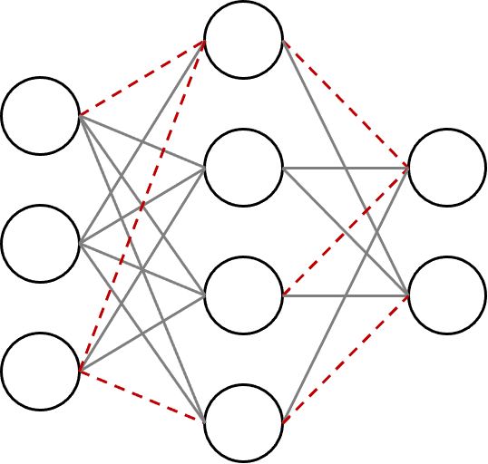
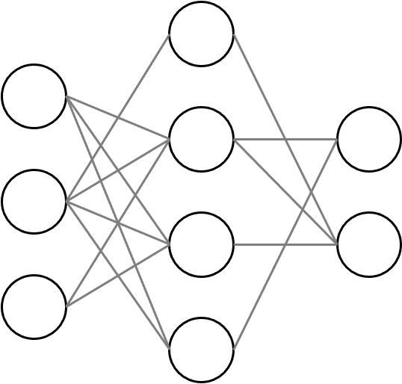
What is neural pruning?
Neural pruning removes redundant parameters such as connections or neurons from a neural network without hurting its predictive performance.
before pruning
after pruning
3

Slide 4
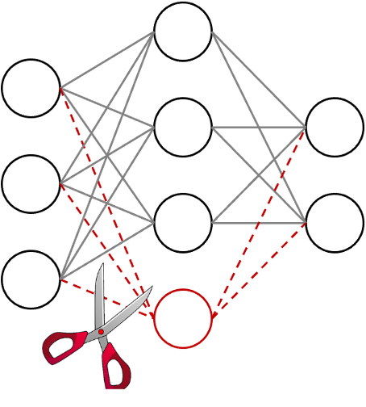
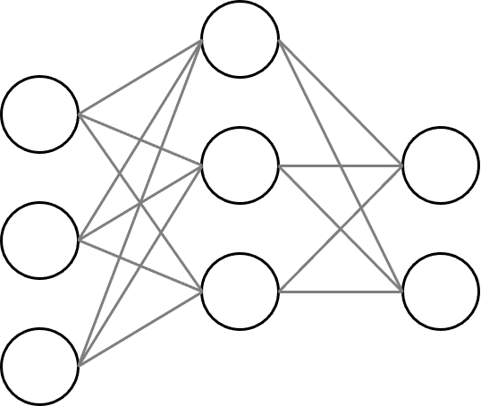
What is neural pruning?
Neural pruning removes redundant parameters such as connections or neurons from a neural network without hurting its predictive performance.
before pruning
after pruning
4

Slide 5
What is neural pruning?
train a neural network from scratch
rank parameters with a criterion for importance
prune least important parameters
fine-tune the remaining network
5

Slide 6
Why neural pruning?
reduce network size, inference time and energy consumption
the AlexNet model - 61M weight parameters - 244MB storage space – 0.7B FLOPs
deployed on mobile/resource-constrained devices
improve generalization
‘two green points [pruned networks with different pruning ratios] achieve slightly better accuracy than the original model…’ (Han et al., 2015)
‘The network's speed improved significantly, and its recognition accuracy increased slightly. (LeCun et al., 1989)
application in continual/incremental learning research area
Song Han, Jeff Pool, John Tran, and William Dally. Learning both weights and connections for efficient neural network. Advances in neural information processing systems, 28, 2015.
Yann LeCun, John Denker, and Sara Solla. Optimal brain damage. Advances in neural information processing systems, 2, 1989.
6

Slide 7
Motivation
Test accuracy of point estimate is currently used as the only evaluation metric
Uncertainty measures are important in safety-critical decision-making.
What is the reliability of a pruned neural network?
Goal: quantify the uncertainty of pruned neural networks

Slide 8
Our contribution
We measured the ICP predictive efficiency of the pruned neural network with several pruning methods on various data sets and network architectures.
We proposed a new pruning method based directly on ICP predictive efficiency.

Slide 9
Inductive Conformal Predictor
Given,
a training set $Z=\left(z_{1},…,z_{k}\right)$, where $z_{i}=\left(x_{i}, y_{i}\right)∈Z;$ $x_{i}∈ℝ^{m}, y_{i}∈Y=\{1,…,C\}$
a calibration set $Z^{c}=\left(z_{k+1},…,z_{l}\right)$
a conformity function $α_{i}=A\left(x_{i}, y_{i}=u\right)=\frac{o_{u}^{i}}{\max_{j=1,…,c:j≠u }o_{j}^{i}}$, (Papadopoulos et al, 2007)
the steps that ICP follows are,
train a neural network $f$ on $Z$
prune the neural network
apply conformity function on $∀z_{i}∈Z^{c}$ to obtain conformity scores, $α_{k+1},…, α_{l}$

Slide 10
Inductive Conformal Predictor
Given,
a test set $Z^{te}=(z_{l+1},…,z_{n})$ (drawn from the same distribution with $Z^{c}$),
$l−k$ calibration conformity scores $α_{k+1},…, α_{l}$
significance level $ε$
The ICP gives the prediction set for an input $x$,
$$Γ^{ε}\left(x\right)= \left\{y∈Y: \sum_{j=k+1}^{l}{𝕀\left(A\left(x, y\right)≥α_{j}\right)+1>}ε(l−k+1)\right\}$$

Slide 11
Inductive Conformal Predictor
Performance Measures
Error rate
$$Err=\frac{1}{n−l}\sum_{i=l+1}^{n}{𝕀(y_{i}∉Γ^{ε}(x_{i}))}$$
Inefficiency
$$Ineff=\frac{1}{n−l}\sum_{i=l+1}^{n}{|Γ^{ε}(x_{i})|}$$
This is not the only measure of inefficiency available but is the one we choose for this study.

Slide 12
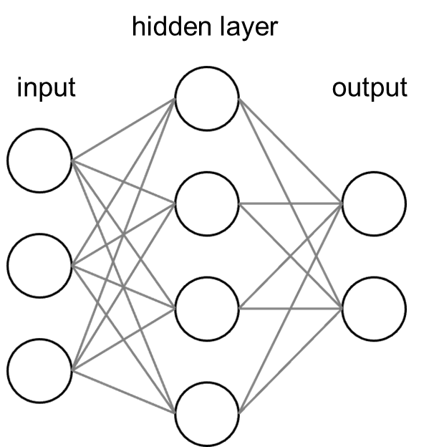
Magnitude-based pruning
Learn $W$ by minimizing the following objective function
$$\min_{W}{ℒ\left(Z, 𝒲\right)+λ\sum_{i=1}^{P}{\sum_{j=1}^{θ_{i}}{\left|w_{i,j}\right|}}}$$
where $𝒲=\{w_{0},…,w_{p}\}$ with each
$w_{i}=(w_{i,1},…,w_{i,θ_{i}})$
P is the total number of hidden units and $θ_{i}$ is the dimension of weight vector

Slide 13
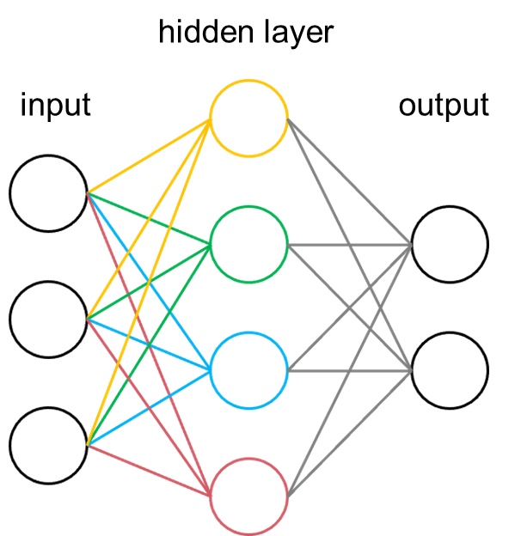
Magnitude-based pruning
Learn $W$ by minimizing the following objective function
$$\min_{W}{ℒ\left(Z, 𝒲\right)+λ\sum_{i=1}^{P}{\sum_{j=1}^{θ_{i}}{\left|w_{i,j}\right|}}}$$
After $ℒ$ converges, the magnitude of each neuron $w_{i}$ is calculated
$$s_{i}={\left\|w_{i}\right\|}_{1}=\sum_{j=1}^{θ_{i}}{\left|w_{i,j}\right|}$$
Prune the neurons that have the smallest magnitude.

Slide 14
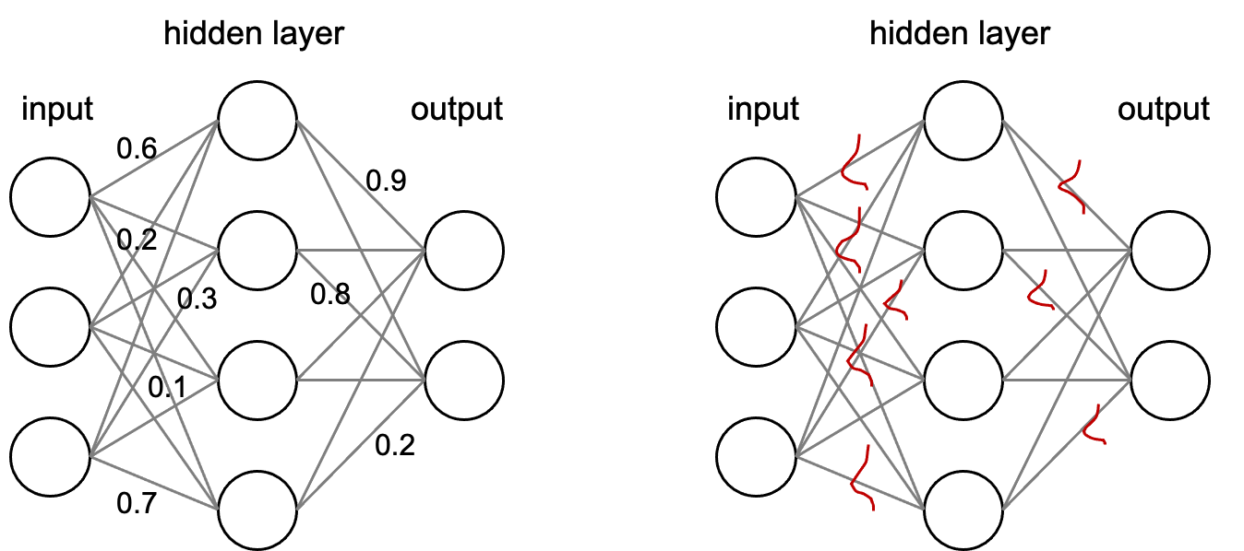
Bayesian learning-based pruning
Standard Neural Network
Bayesian Neural Network

Slide 15
Bayesian learning-based pruning
Prior distribution
$$p\left(𝒲\right)= \prod_{i=1}^{P}{\prod_{j=1}^{θ_{i}}{𝒩(w_{i,j}|0,1)}}$$
Approximate posterior distribution
$q\left(𝒲\right)= \prod_{i=1}^{P}{\prod_{j=1}^{θ_{i}}{𝒩(w_{i,j}|μ_{i,j},σ_{i,j})}}$
where $φ{=\{μ_{i,j},σ_{i,j}\}}_{ i=1, j=1}^{ P, θ_{i}}$ are learnable parameters

Slide 16
Bayesian learning-based pruning
We train a BNN from scratch,
$ℒ\left(Z,φ\right)=𝔼_{q(𝒲|φ)}\left[−\log{p\left(Z | 𝒲\right)}\right]+D_{kl}(q(𝒲|φ)||p\left(𝒲\right))$
Then, prune the weights that have the relatively high probabilities of being zero. It is equivalent to computing the signal-to-noise ratio, i.e.,
$${snr}_{i,j}=\left|\frac{μ_{i,j}}{σ_{i,j}}\right|$$
The larger the ratio, the more important the weight parameter.

Slide 17
CP efficiency-based pruning
The intuition behind our method is:
if the removal of a single neuron results in larger inefficiency, then this neuron should be kept;
if the removal of a single neuron results in smaller inefficiency or does not change the inefficiency, then this neuron should be pruned.

Slide 18
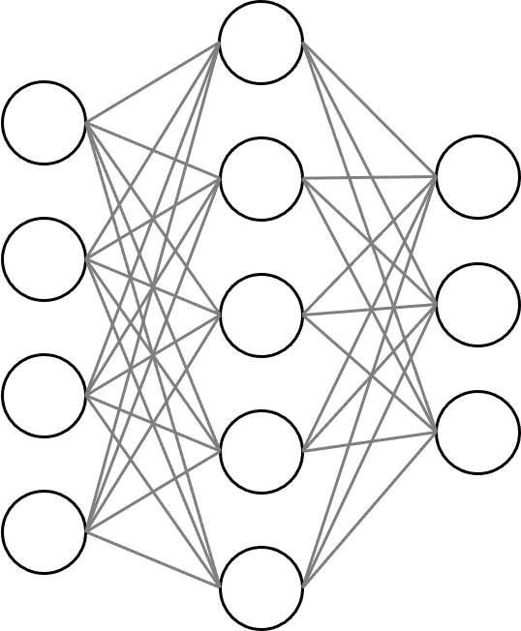
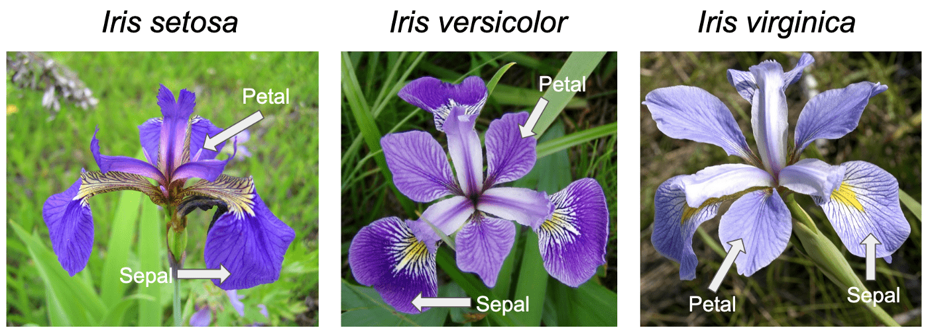
CP efficiency-based pruning
Given,
a proper training set $Z^{t}=\left(z_{1},…,z_{ν}\right)$
a training set $Z=\left(z_{1},…,z_{k}\right)$
a validation set $Z^{v}=\left(z_{ν+1},…,z_{l}\right)$
a calibration set $Z^{c}=\left(z_{k+1},…,z_{l}\right)$
a test set $Z^{te}=(z_{l+1},…,z_{n})$

Slide 19
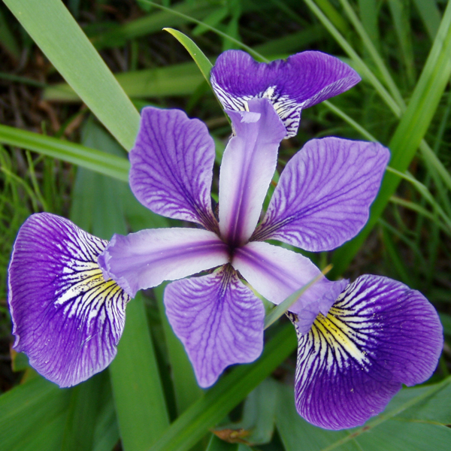
CP efficiency-based pruning
$$Ineff=\frac{1}{l−ν}\sum_{i=ν+1}^{l}{|Γ^{ε}(x_{i})|}$$
ICP framework
prediction sets
$$Ineff (a_{0})=1.5$$
validation
image
trained NN
trained NN

Slide 20
CP efficiency-based pruning
ICP framework
1
prediction sets
$$Ineff (a_{1})=2.1$$
validation
image
trained NN

Slide 21
CP efficiency-based pruning
ICP framework
2
prediction sets
$$Ineff (a_{2})=1.2$$
validation
image
trained NN

Slide 22
CP efficiency-based pruning
ICP framework
3
prediction sets
$$Ineff (a_{3})=1.5$$
validation
image
trained NN

Slide 23
CP efficiency-based pruning
ICP framework
prediction sets
$$Ineff (a_{4})=1.8$$
4
validation
image
trained NN

Slide 24
CP efficiency-based pruning
ICP framework
prediction sets
$$Ineff (a_{5})=2.7$$
validation
image
5
trained NN

Slide 25
CP efficiency-based pruning
$a_{0}=1.5$ (baseline), $a_{1}=2.1$, $a_{2}=1.2$, $a_{3}=1.5$, $a_{4}=1.8$, $a_{5}=2.7$
Two way to measure difference between $a_{0}$ and $a_{i}$, where $i=1,…,5$
1) sign method: $δ_{i}^{sign}=a_{i}−a_{0}$ 2) abs method: $δ_{i}^{abs} =\left|a_{i}−a_{0}\right|$
 | sign method | abs method
$$δ_{1}$$ | 0.6 | 0.6
$$δ_{2}$$ | -0.3 | 0.3
$$δ_{3}$$ | 0 | 0
$$δ_{4}$$ | 0.3 | 0.3
$$δ_{5}$$ | 1.2 | 1.2

Slide 26
CP efficiency-based pruning
the number of pruned neurons
pruning ratio $=$
total number of neurons
pruning ratio | sign method $$δ_{2}<δ_{3}<δ_{4}<δ_{1}<δ_{5}$$ | abs method $$δ_{3}<δ_{2}=δ_{4}<δ_{1}<δ_{5}$$
20% | neuron #2 | neuron #3
40% | neurons #2 & 3 | neurons #2 & 3
60% | neurons #2, 3 & 4 | neurons #2, 3 & 4
80% | neurons #2, 3, 4 & 1 | neurons #2, 3, 4 & 1

Slide 27
Experiments and results
Dataset
MNIST is an image classification dataset. It contains $28×28$ greyscale images of handwritten digits 0-9. Its training set contains 60,000 examples and test set contains 10,000 examples.
fashionMNIST is an image classification dataset. It contains $28×28$ greyscale images of fashion products such as T-shirts, sandals and bags. Its training set contains 60,000 examples and test set contains 10,000 examples.
Dataset | Features | Classes | $$\#Z^{t}$$ | $$\#Z^{c}$$ | $$\#Z^{v}$$ | $$\#Z^{te}$$
MNIST | 784 | 10 | 20,000 | 20,000 | 20,000 | 10,000
fashionMNIST | 784 | 10 | 20,000 | 20,000 | 20,000 | 10,000

Slide 28
Experiments and results
Network architecture
Architecture #1
hidden unit – hidden unit: 500 – 300
total # of parameters: 545,810
Architecture #2
hidden unit – hidden unit – hidden unit: 1024 – 1024 – 512
total # of parameters: 2,383,370
over-parameterized neural network:
the # of neural network parameters $≫$ the # of training examples

Slide 29
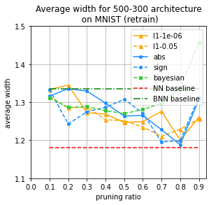
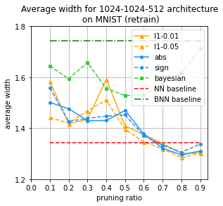
Experiments and results

Slide 30
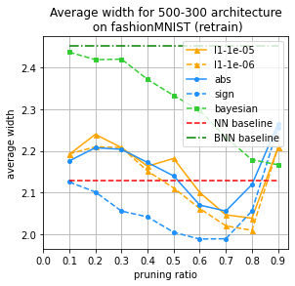
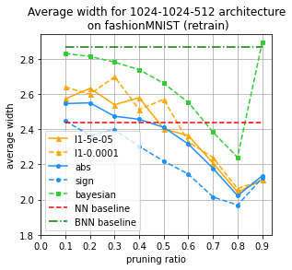
Experiments and results

Slide 31
Experiments and results
Dataset
Covtype is a multivariate dataset. It describes 581, 012 forest covers with 54 cartographic variables and their 7 species.
Dataset | Features | Classes | $$\#Z^{t}$$ | $$\#Z^{c}$$ | $$\#Z^{v}$$ | $$\#Z^{te}$$
Covtype | 54 | 7 | 145,253 | 145,253 | 145,253 | 145,253

Slide 32
Experiments and results
Network architecture
Architecture #1
hidden unit – hidden unit: 500 – 300
total # of parameters: 545,810
Architecture #2
hidden unit – hidden unit – hidden unit: 1024 – 1024 – 512
total # of parameters: 2,383,370
Architecture #3
hidden unit – hidden unit – hidden unit: 128 – 128 – 128
total # of parameters: 40,967
under-parameterized neural network:
the # of neural network parameters $≪$ the # of training examples

Slide 33
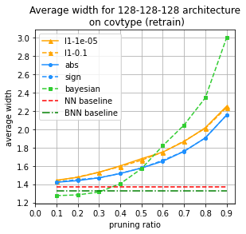
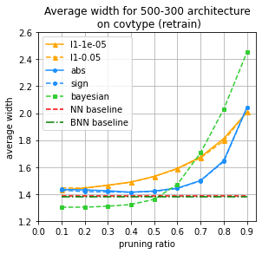
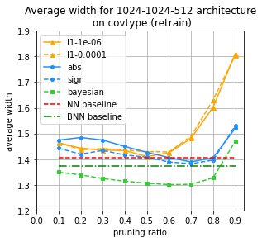
Experiments and results
total # of parameters:
40,967
total # of parameters:
545,810
total # of parameters:
2,383,370
under-parameterized
over-parameterized
sufficiently
over-parameterized

Slide 34
Overparameterization
& Generalization
overparameterized neural network leads to bad generalization and thus pruning improves generalization (Urolagin et al., 2011)
overparameterized neural network is observed to generalize well
and benefits pruning (Chang et al., 2020)

Slide 35
Conclusion
We demonstrate that a neural network can be pruned whilst maintaining its conformal prediction efficiency at a particular pruning ratio.
We propose a new pruning method based on conformal predictor efficiency whose results are shown to be competitive

Slide 36
Conclusion
Limitation
In our proposed method, computing the inefficiency change for each neuron is computationally expensive since we need perform conformal prediction P times, one for each removed neuron, if we have P neurons in total.
Future work
improve computational efficiency by exploring a reduced pruning search space
extend our method to deep convolutional neural networks
explore in the context of continual learning.

Slide 37
Thank you for your attention!

Slide 38
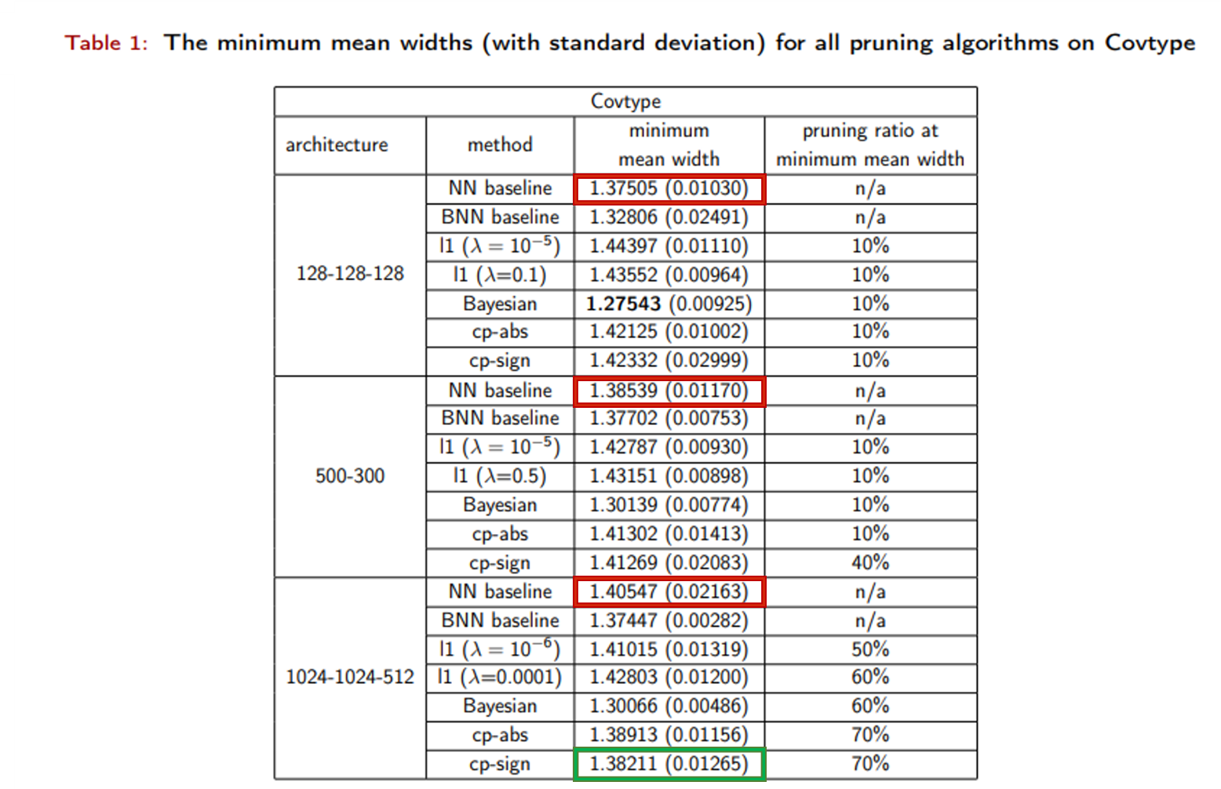
Overparameterization
& Generalization

Slide 39
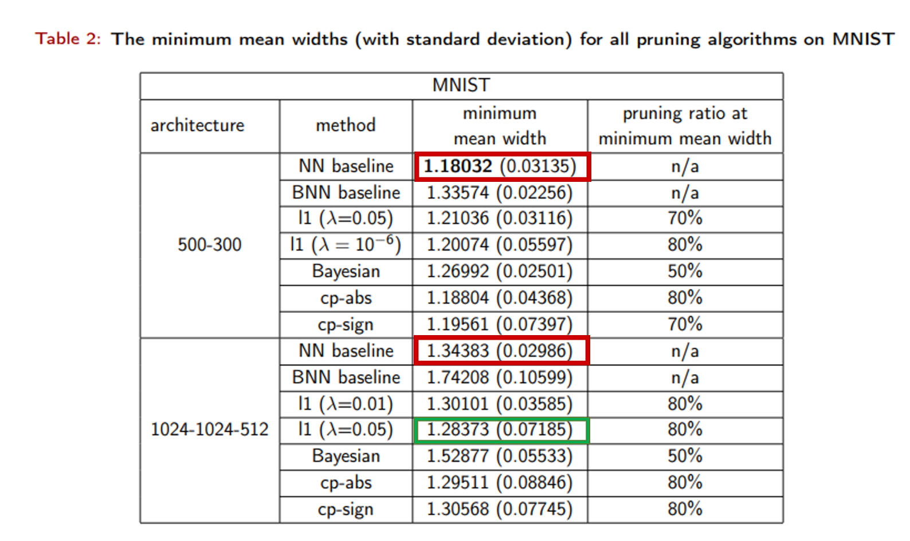
Overparameterization
& Generalization

Slide 40
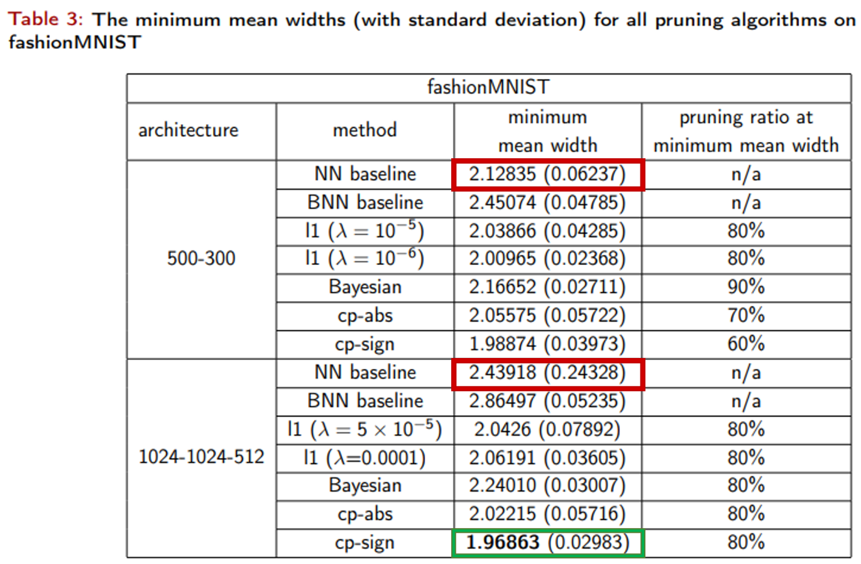
Overparameterization
& Generalization

